Slide 1
Intro to Domain-Specific Software Engineering
Software Architecture
Lecture 23

Slide 2
Objectives
Concepts
  What is domain-specific software engineering (DSSE)
  The “Three Lampposts” of DSSE: Domain, Business, and Technology
  Domain Specific Software Architectures
Product Lines
Relationship between DSSAs, Product Lines, and Architectural Styles
Examples of DSSE at work

Slide 3
Objectives
Concepts
  What is domain-specific software engineering (DSSE)
  The Three Key Factors of DSSE: Domain, Business, and Technology
  Domain Specific Software Architectures
Product Lines
Relationship between DSSAs, Product Lines, and Architectural Styles
Examples of DSSE at work

Slide 4
Domain-Specific Software Engineering
The traditional view of software engineering shows us how to come up with solutions for problems de novo
But starting from scratch every time is infeasible
  This will involve re-inventing many wheels
Once we have built a number of systems that do similar things, we gain critical knowledge that lets us exploit common solutions to common problems
  In theory, we can simply build “the difference” between our new target system and systems that have come before

Slide 5
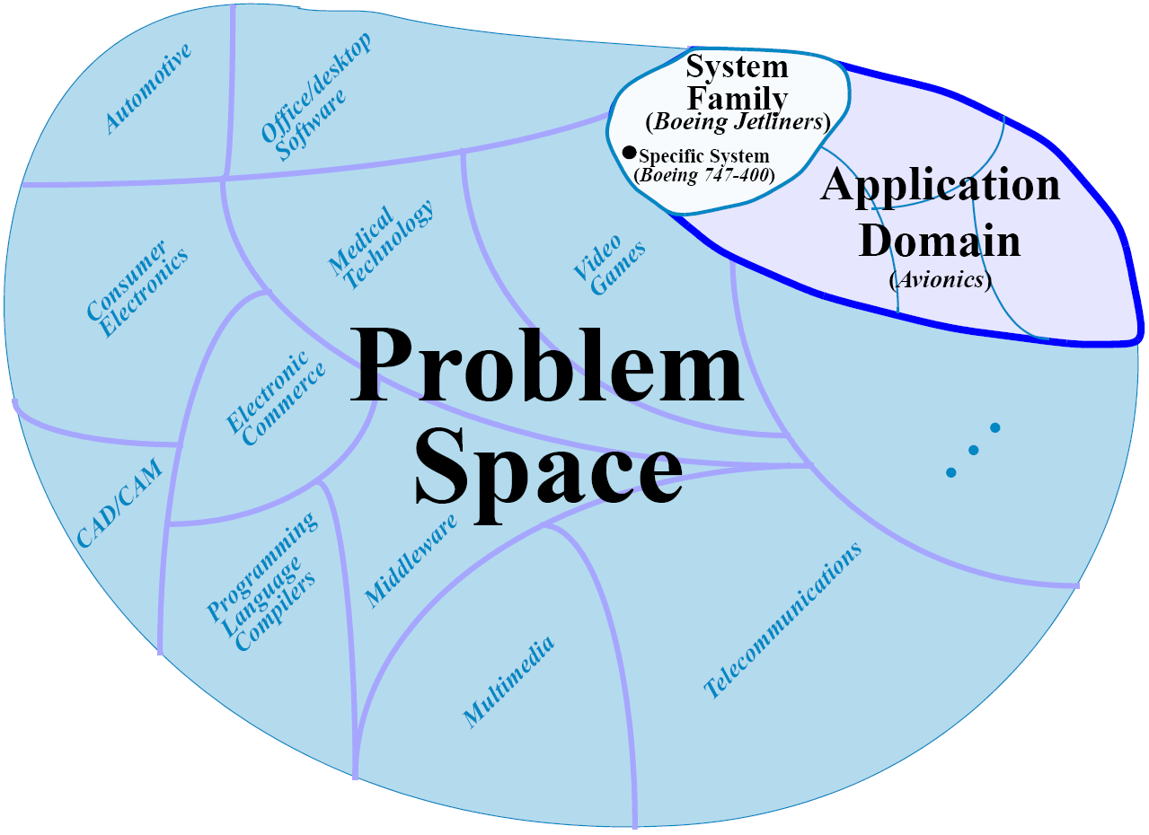
Examples of Domains
Compilers for programming languages
Consumer electronics
Electronic commerce system/Web stores
Video game
Business applications
  Basic/Standard/“Pro”
We can subdivide, too:
  Avionics systems
    Boeing Jets
      Boeing 747-400
Software Architecture: Foundations, Theory, and Practice; Richard N. Taylor, Nenad Medvidovic, and Eric M. Dashofy; (C) 2008 John Wiley & Sons, Inc. Reprinted with permission.

Slide 6
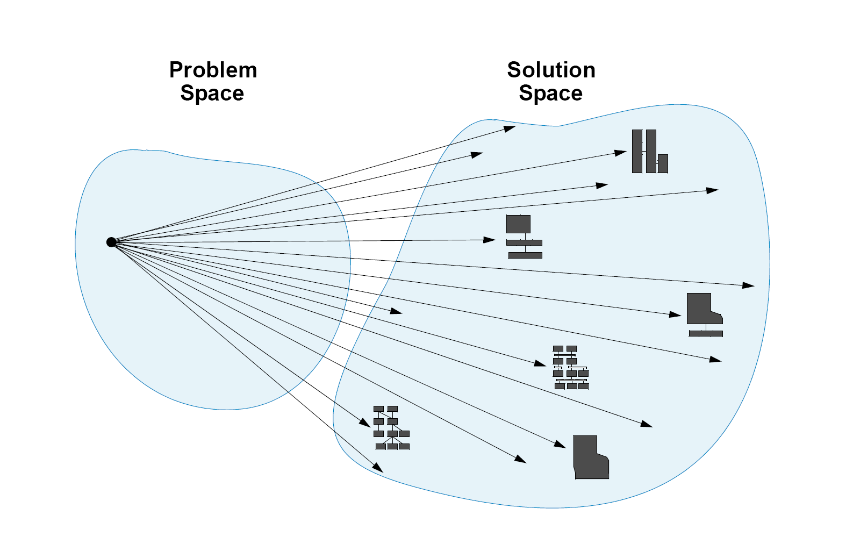
Traditional Software Engineering
One particular problem can be solved in innumerable ways
Software Architecture: Foundations, Theory, and Practice; Richard N. Taylor, Nenad Medvidovic, and Eric M. Dashofy; (C) 2008 John Wiley & Sons, Inc. Reprinted with permission.

Slide 7
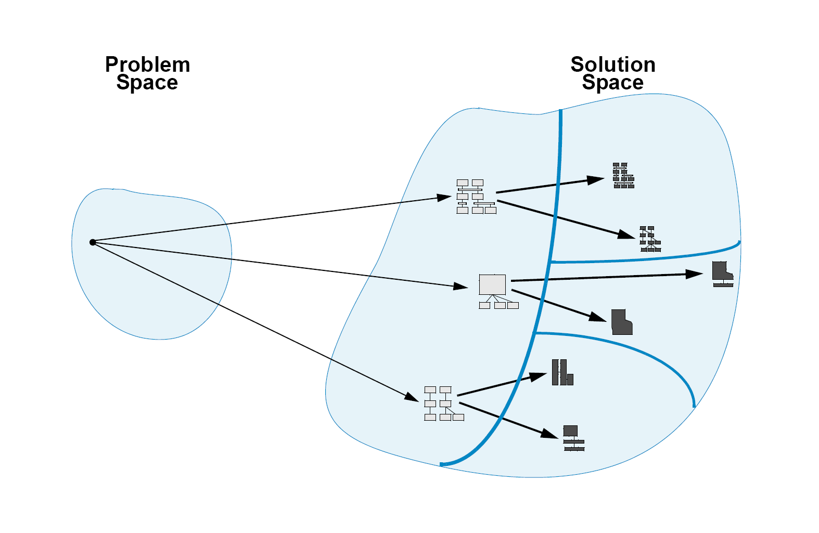
Architecture-Based Software Engineering
Given a single problem, we select from a handful of potential architectural styles or architectures, and go from these into specific implementations
Software Architecture: Foundations, Theory, and Practice; Richard N. Taylor, Nenad Medvidovic, and Eric M. Dashofy; (C) 2008 John Wiley & Sons, Inc. Reprinted with permission.

Slide 8
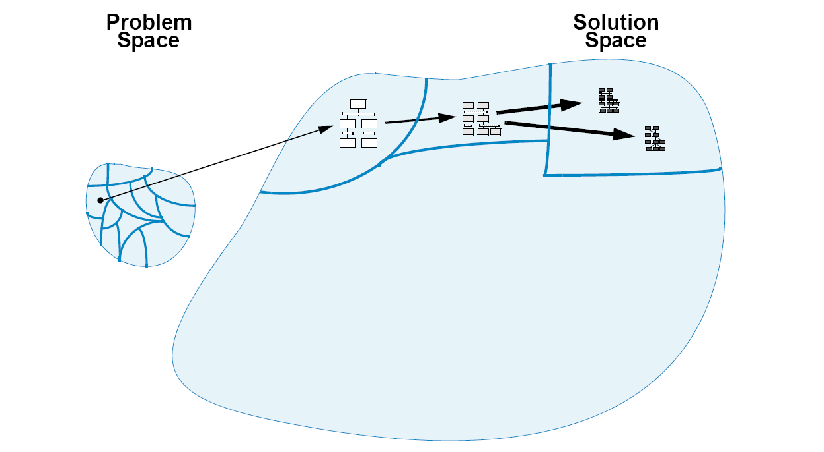
Domain-Specific Software Engineering
We map regions of the problem space (domains) into domain-specific software architectures (DSSAs)
These are specialized into application-specific architectures
These are implemented
Software Architecture: Foundations, Theory, and Practice; Richard N. Taylor, Nenad Medvidovic, and Eric M. Dashofy; (C) 2008 John Wiley & Sons, Inc. Reprinted with permission.

Slide 9
Three Key Factors of DSSE
Domain
  Must have a domain to constrain the problem space and focus development
Technology
  Must have a variety of technological solutions—tools, patterns, architectures & styles, legacy systems—to bring to bear on a domain
Business
  Business goals motivate the use of DSSE
    Minimizing costs: reuse assets when possible
    Maximize market: develop many related applications for different kinds of end users

Slide 10
Three Key Factors
Domain
  Must have a domain
  to constrain the
  problem space
  and focus
  development
Domain
Business
Technology

Slide 11
Three Key Factors
Technology
  Must have a variety of technological solutions—tools, patterns, architectures & styles, legacy systems—to bring to bear on a domain
Domain
Business
Technology

Slide 12
Three Key Factors
Business
  Business goals motivate the use of DSSE
    Minimizing costs: reuse assets
    when possible
    Maximize market: develop many related applications for different kinds of end users
Domain
Business
Technology

Slide 13
Three Key Factors
Domain + Business
“Corporate Core
Competencies”
  Domain expertise
  augmented by
  business
  acumen and
  knowledge of
  the market
Domain
Business
Technology

Slide 14
Three Key Factors
Domain + Technology
“Application Family
Architectures”
  All possible
  technological
  solutions to
  problems in a
  domain
  Uninformed
  and unconstrained by
  business goals
  and knowledge
Domain
Business
Technology

Slide 15
Three Key Factors
Business + Technology
“Domain independent
infrastructure”
  Tools and
  techniques for
  constructing
  systems
  independent of any
  particular domain
  E.g., most generic ADLs, UML, compilers, word processors, general-purpose PCs
Domain
Business
Technology

Slide 16
Three Key Factors
Domain + Business + Technology
“Domain-specific
software engineering”
Applies technology
to domain-specific
goals, tempered by
business and market
knowledge
Domain
Business
Technology

Slide 17
Three Key Factors
Product-Line Architectures
A specific, related set
of solutions within
a broader DSSE
More focus on
commonalities and
variability between
individual solutions
Domain
Business
Technology

Slide 18
Becoming More Concrete
Applying DSSE means developing a set of artifacts more specific than an ordinary software architecture
  Focus on aspects of the domain
  Focus on domain-specific solutions, techniques, and patterns
These are
  A domain model and
  A domain-specific software architecture (DSSA)

Slide 19
Domain Model
A domain model is a set of artifacts that capture information about a domain
  Functions performed
  Objects (also known as entities) that perform the functions, and on which the functions are performed
  Data and information that flows through the system
Standardizes terminology and semantics
Provides the basis for standardizing (or at least normalizing) descriptions of problems to be solved in the domain

Slide 20
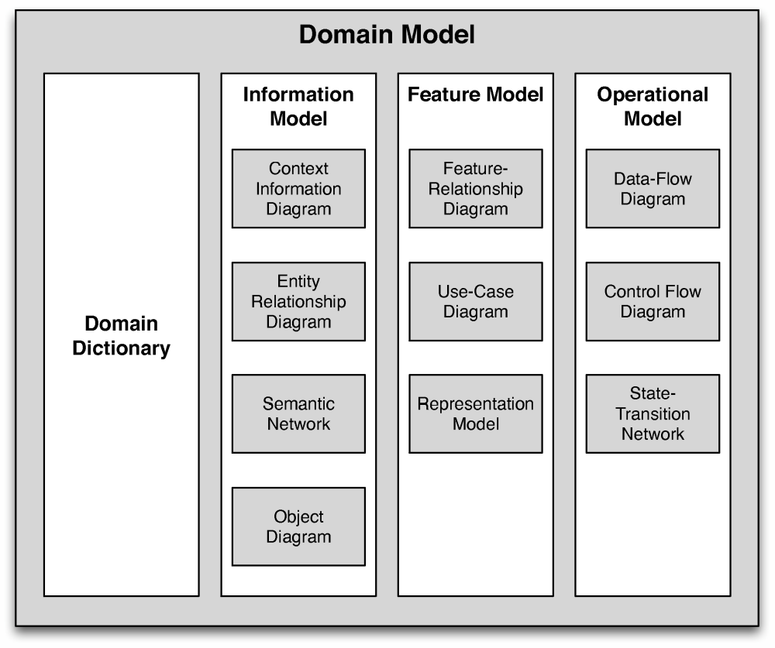
Domain Model
Software Architecture: Foundations, Theory, and Practice; Richard N. Taylor, Nenad Medvidovic, and Eric M. Dashofy; (C) 2008 John Wiley & Sons, Inc. Reprinted with permission.

Slide 21
Domain Model
Defines vocabulary for the domain
Software Architecture: Foundations, Theory, and Practice; Richard N. Taylor, Nenad Medvidovic, and Eric M. Dashofy; (C) 2008 John Wiley & Sons, Inc. Reprinted with permission.

Slide 22
Domain Model
Describes the entities and data in the domain
Software Architecture: Foundations, Theory, and Practice; Richard N. Taylor, Nenad Medvidovic, and Eric M. Dashofy; (C) 2008 John Wiley & Sons, Inc. Reprinted with permission.

Slide 23
Domain Model
Defines how entities and data combine to provide features
Software Architecture: Foundations, Theory, and Practice; Richard N. Taylor, Nenad Medvidovic, and Eric M. Dashofy; (C) 2008 John Wiley & Sons, Inc. Reprinted with permission.

Slide 24
Domain Model
Defines how data and control flow through entities
Software Architecture: Foundations, Theory, and Practice; Richard N. Taylor, Nenad Medvidovic, and Eric M. Dashofy; (C) 2008 John Wiley & Sons, Inc. Reprinted with permission.

Slide 25
(Partial) Domain Dictionary
Lunar Module (LM): this is the portion of the spacecraft that lands on the moon.
It consists of two main parts: the Ascent Stage (which holds the crew cabin) and the
Descent Stage, which contains thrusters used for controlling the landing of the LM.
Reaction Control System (RCS): a system on the Lunar Module responsible for the
stabilization during lunar surface ascent/descent and control of the spacecraft’s orientation
(attitude) and motion (translation) during maneuvers
Vertical velocity (see also One-dimensional motion):
For a free-falling object with no air resistance, ignoring the rotation of the lunar surface,
the altitude is calculated as follows:
y = ½ * a * t₂ + v_{i} * t + y_{i}
y = altitude
a = constant acceleration due to gravity on a lunar body (see Acceleration for sample values)
t = time in seconds; v_{i} = initial velocity; y_{i} = initial altitude
When thrust is applied, the following equation is used:
y = ½ * (a_{burner} – a_{gravity}) * t₂ + v_{i} * t + y_{i}
y = altitude
a_{burner} = constant acceleration upward due to thrust
a_{gravity} = constant acceleration due to gravity on a lunar
(see Acceleration for sample values)
t = time in seconds; v_{i} = initial velocity; y_{i} = initial altitude
Software Architecture: Foundations, Theory, and Practice; Richard N. Taylor, Nenad Medvidovic, and Eric M. Dashofy; (C) 2008 John Wiley & Sons, Inc. Reprinted with permission.

Slide 26
Info Model: Context Info Diagram
Defines high-level entities
Defines what is considered inside and outside the domain (or subdomains)
Defines relationships and high-level flows
Software Architecture: Foundations, Theory, and Practice; Richard N. Taylor, Nenad Medvidovic, and Eric M. Dashofy; (C) 2008 John Wiley & Sons, Inc. Reprinted with permission.

Slide 27
Info Model: Entity-Relationship Diagram
Defines entities
and cardinal relationships between them
Software Architecture: Foundations, Theory, and Practice; Richard N. Taylor, Nenad Medvidovic, and Eric M. Dashofy; (C) 2008 John Wiley & Sons, Inc. Reprinted with permission.

Slide 28
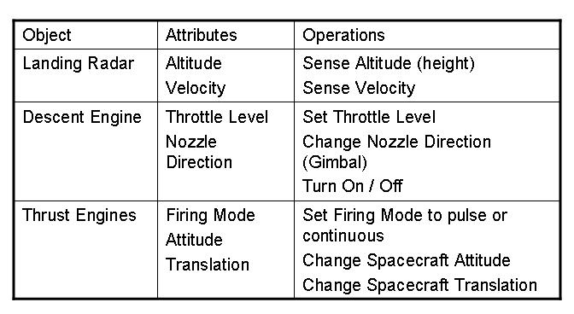
Info Model: Object Diagram
Defines attributes and operations on entities
Closely resembles class diagram in UML but may be more abstract
Software Architecture: Foundations, Theory, and Practice; Richard N. Taylor, Nenad Medvidovic, and Eric M. Dashofy; (C) 2008 John Wiley & Sons, Inc. Reprinted with permission.

Slide 29
Feature Model: Feature Relationship Diagram
Feature Relationship Diagram – Landing Phase
Mandatory: The Lunar Lander must continually read altitude from the Landing Radar and
relay that data to Houston with less than 500 msec of latency. Astronauts must be able to
control the descent of the Lunar Lander using manual control on the descent engine.
The descent engine must respond to control commands in 250msec, with or without
a functioning DSKY…
Optional/Variant: Lunar Lander provides the option to land automatically or allow the
crew to manually steer the spacecraft.
Quality Requirements:
Real-time requirements: The thrusters and the descent engine must be able to respond to
commands from the computer system in real-time.
Fault tolerance: Lunar Lander must be able to continue in its flight-path even when the
main computer system (Primary Navigation Guidance & Control) goes down. Lunar Lander
must be able to maintain system altitude even when one of the thrusters and propellant
supplies goes down in the Reaction Control System.
Describes overall mission operations of a system
Describes major features and decomposition
Software Architecture: Foundations, Theory, and Practice; Richard N. Taylor, Nenad Medvidovic, and Eric M. Dashofy; (C) 2008 John Wiley & Sons, Inc. Reprinted with permission.

Slide 30
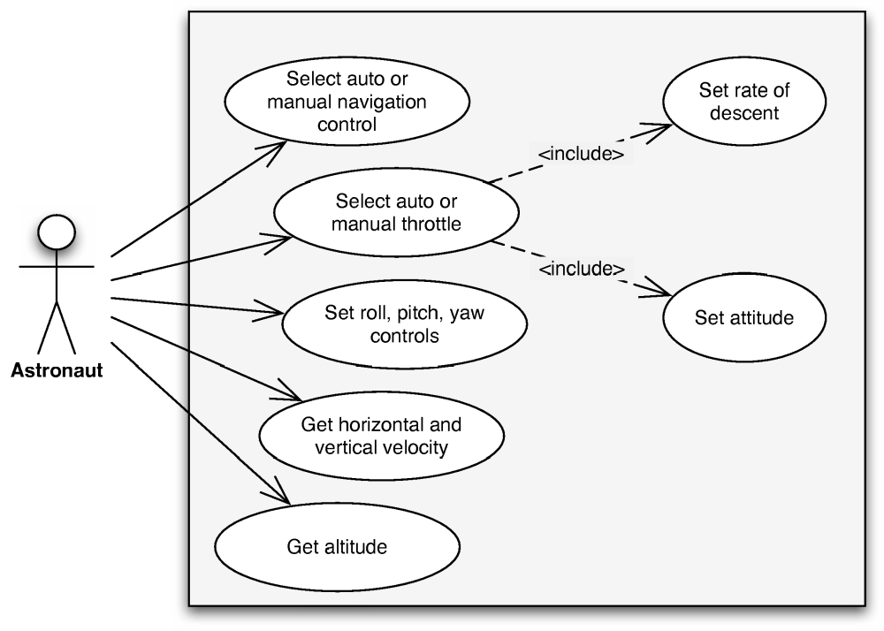
Feature Model: Use Case Diagram
Defines use cases
within the domain
Similar to use case
models in UML
Software Architecture: Foundations, Theory, and Practice; Richard N. Taylor, Nenad Medvidovic, and Eric M. Dashofy; (C) 2008 John Wiley & Sons, Inc. Reprinted with permission.

Slide 31
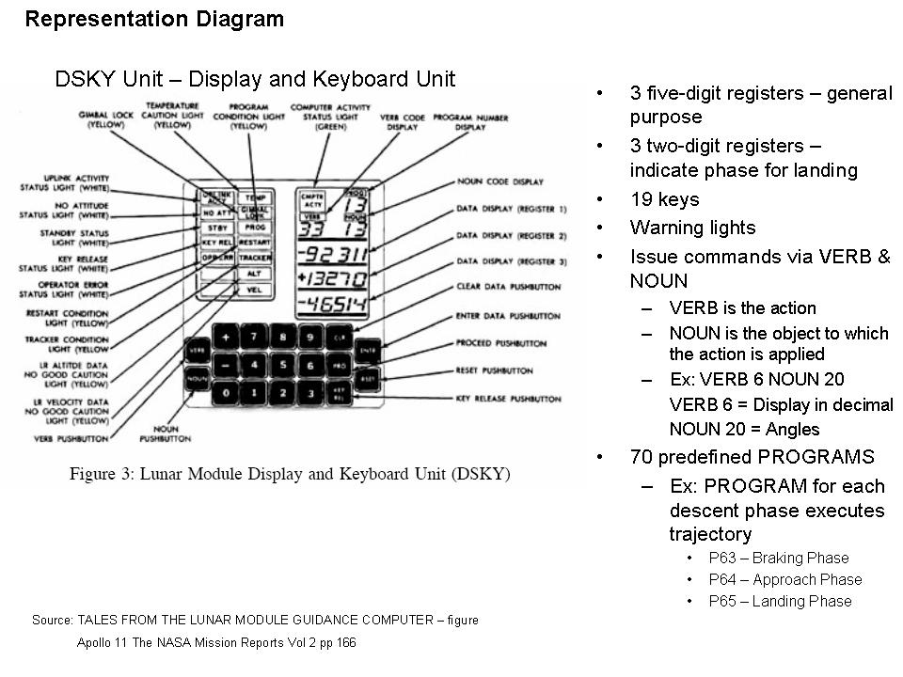
Feature Model: Representation Diagram
Defines how
information is
presented to
human users
Software Architecture: Foundations, Theory, and Practice; Richard N. Taylor, Nenad Medvidovic, and Eric M. Dashofy; (C) 2008 John Wiley & Sons, Inc. Reprinted with permission.

Slide 32
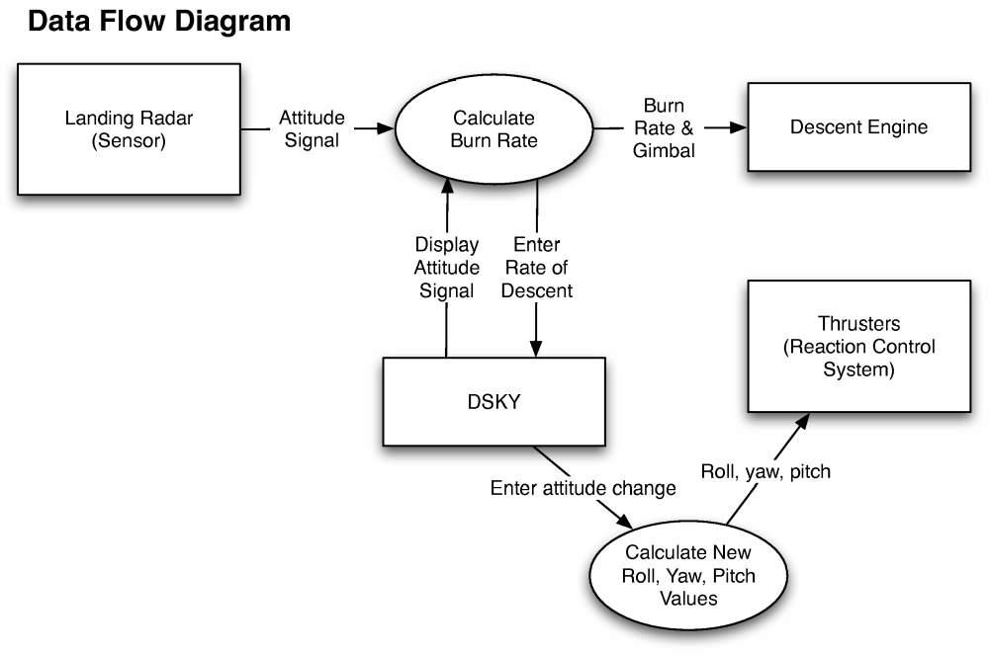
Operational Model: Data Flow Diagram
Focuses on
data flow between
entities with no
notion of control
Software Architecture: Foundations, Theory, and Practice; Richard N. Taylor, Nenad Medvidovic, and Eric M. Dashofy; (C) 2008 John Wiley & Sons, Inc. Reprinted with permission.

Slide 33
Operational
Model:
Control Flow
Diagram
Focuses on
control flow between
entities separate from
data flow
Software Architecture: Foundations, Theory, and Practice; Richard N. Taylor, Nenad Medvidovic, and Eric M. Dashofy; (C) 2008 John Wiley & Sons, Inc. Reprinted with permission.

Slide 34
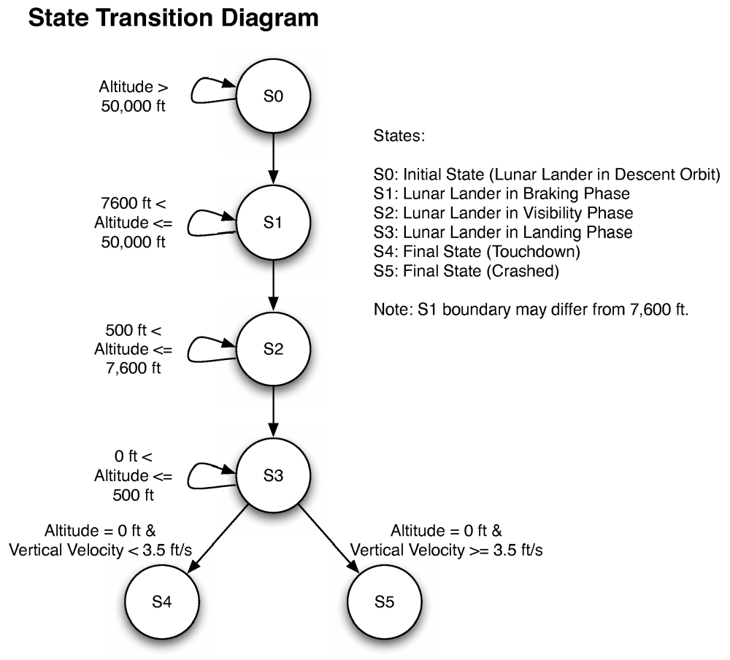
Operational Model: State Transition Diagram
Focuses on states
of systems and
transitions between
them
Resembles UML
state diagrams
Software Architecture: Foundations, Theory, and Practice; Richard N. Taylor, Nenad Medvidovic, and Eric M. Dashofy; (C) 2008 John Wiley & Sons, Inc. Reprinted with permission.

Slide 35
Reference Requirements
Mandatory
  Must display the current status of the Lunar Lander (horizontal and vertical velocities, altitude, remaining fuel)
  Must indicate points earned by player based on quality of landing
Optional
  May display time elapsed
Variant
  May have different levels of difficulty based on pilot experience (novice, expert, etc)
  May have different types of input depending on whether
    Auto Navigation is enabled
    Auto Throttle is enabled
  May have to land on different celestial bodies
    Moon
    Mars
    Jupiter’s moons
    Asteroid
Software Architecture: Foundations, Theory, and Practice; Richard N. Taylor, Nenad Medvidovic, and Eric M. Dashofy; (C) 2008 John Wiley & Sons, Inc. Reprinted with permission.

Slide 36
Domain-Specific Software Architecture
Definition: Definition. A domain-specific software architecture (DSSA) comprises:
  a reference architecture, which describes a general computational framework for a significant domain of applications;
  a component library, which contains reusable chunks of domain expertise; and
  an application configuration method for selecting and configuring components within the architecture to meet particular application requirements.
(Hayes-Roth)

Slide 37
Reference Architecture
Definition. Reference architecture is the set of principal design decisions that are simultaneously applicable to multiple related systems, typically within an application domain, with explicitly defined points of variation.
Reference architectures are still architectures (since they are also sets of principal design decisions)
  Distinguished by the presence of explicit points of variation (explicitly “unmade” decisions)

Slide 38
Different Kinds of Reference Architecture
Complete single product architecture
  A fully worked out exemplar of a system in a domain, with optional documentation as to how to diversify
    Can be relatively weak due to lack of explicit guidance and possibility that example is a ‘toy’
Incomplete invariant architecture
  Points of commonality as in ordinary architecture, points of variation are indicated but omitted
Invariant architecture with explicit variation
  Points of commonality as in ordinary architecture, specific variations indicated and enumerated

Slide 39
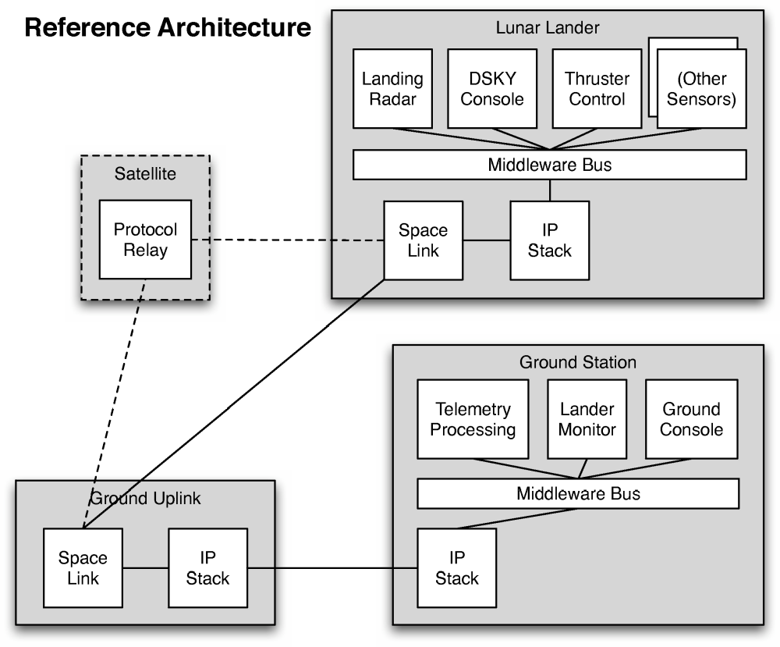
Example Reference Architecture
Structural view
of Lunar Lander
DSSA
Invariant with
explicit points
of variation
  Satellite relay
  Sensors
Software Architecture: Foundations, Theory, and Practice; Richard N. Taylor, Nenad Medvidovic, and Eric M. Dashofy; (C) 2008 John Wiley & Sons, Inc. Reprinted with permission.

